Slide 1


Vacation Rental Property Finder In South FL
By: Jim Lao, Mark Olson, and Krishna Pandari

Slide 2
Project Overview
The Vacation rental property finder/comparison tool aims to assist users in finding, comparing, and suggesting rental properties for their stays based on destination, price, ratings, and amenities. Whether planning a getaway or relocating, users can explore available properties, filter based on preferences, and visualize essential information.
With an emphasis on the data visualization track.

Slide 3
Data Gathering
Airbnb/VRBO
Web scrape the data from their web pages
Create Database
Store data into a data table to be used to create visualizations
Create Tables/Views
Using the source data create supporting data tables needed for views
We also explored AirDna, Tripadvisor, Expedia.

Slide 4

Web Scraping
We extracted 23,830 properties from Airbnb and VRBO in Florida:
Identify the Websites: We targeted two popular vacation rental websites, Airbnb and VRBO, to gather property listings.
Set Up the Tools: We used Python along with libraries like requests for making web requests, BeautifulSoup for parsing HTML, and csv for saving the data.
Define the URLs: We specified the URLs for the search results pages on both Airbnb and VRBO, focusing on properties in Florida.
Send Requests: We sent GET requests to these URLs to fetch the HTML content of the search results pages.
Parse the HTML: Using BeautifulSoup, we parsed the HTML content to find the property listings.
Extract Data: We extracted relevant information from each property listing, such as property ID, title, URL, price, latitude, longitude, and ratings.
Save to CSV: We saved the extracted data into CSV files, ensuring that we appended new data to the existing file if it already existed.
Repeat for Multiple Pages: We repeated the process for multiple pages of search results to gather a comprehensive dataset.
By following these steps, we successfully extracted detailed information on 23,830 properties in Florida from Airbnb and VRBO

Slide 5
Data tables / Storage
Once the data has been scraped from the Airbnb and VRBO Web Pages we begin the data cleaning process
We viewed the data and only kept any relevant data for analysis and data visualizations as needed.
Once we had the data cleaned and workable we merged the two datasets together and moved them into one table so the data isn’t stored in multiple tables. So when we create new data tables or views everything is stored in one source table.

Slide 6
Flask API server / Web frontend
Backend
Frontend
Three FLASK API endpoints
1. index/
Parameters: none
Result: Loads the Frontend ( renders index.html )
2. get_properties()
Parameters: destination, min_price, max_price, bedrooms, bathrooms
Returns: json list of dictionaries containing property details
3. get_destinations()
Parameters: none
Returns: json list of city location names
SQLAlchemy Interface to PostgreSQL
Data Mapping
SQL calls
HTML
Main structure of the web page
Selection controls
Fetch button … triggers Javascript
Leaflet / SweetAlert2
Map Background (tiles) Layer
Markers with Popups
JavaScript
1. Initial page load
Loads Leaflet map background
API call to get_properties() & map markers
API call to get_destination() & drop-down
2. Selection controls were modified
API call to get_properties() & map markers

Slide 7
Show HTML DEMO

Slide 8
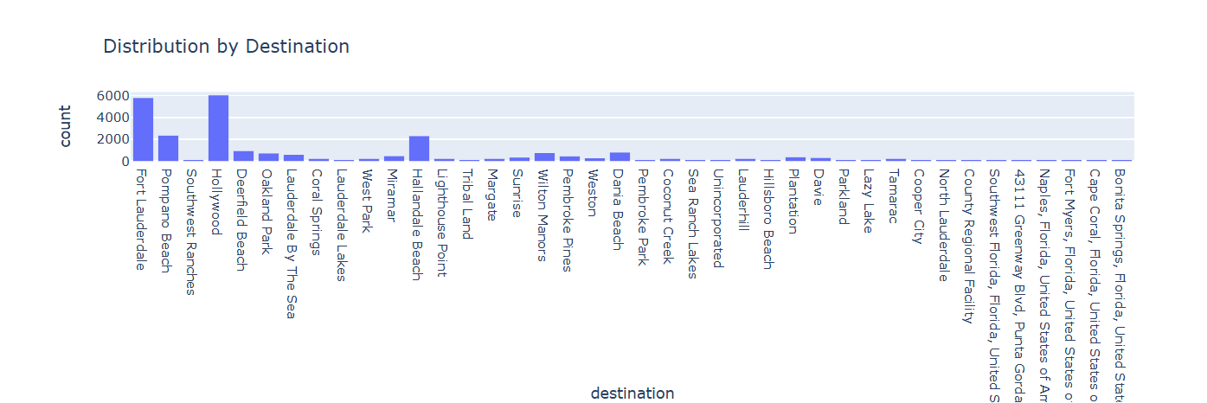
Location
When looking at the location pulled from the scraping we see that most of the rental locations are either in Fort Lauderdale, Hollywood, and Hallandale Beach.
From what we can see from the data is that these locations are where vacation goers are most likely to venture out to.

Slide 9
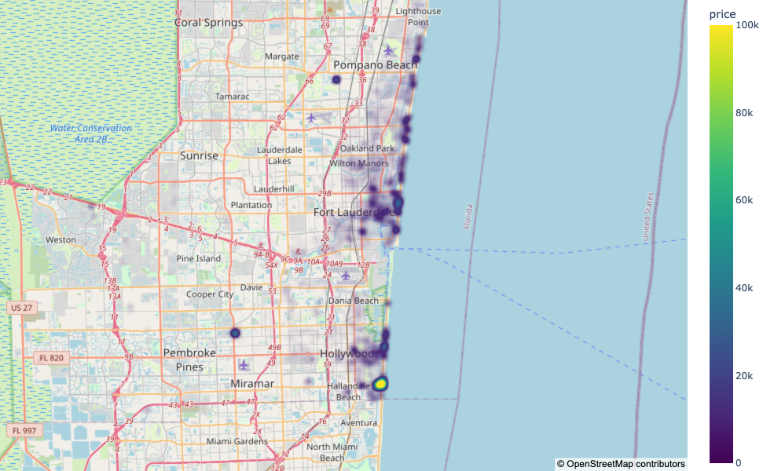
Density Map of Rental Properties in SE FL

Slide 10
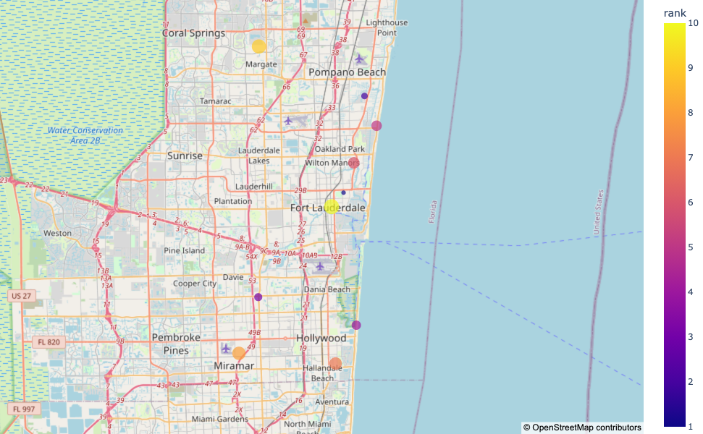
Top 10 Rental Locations – SE FL

Slide 11
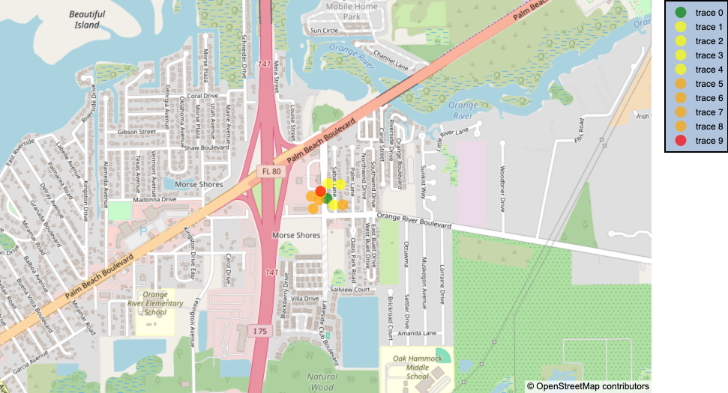
Top 10 Rental Locations – SW FL
Property IDs and Titles:
ID: 3894161, Title: Luxe 3-Bed Condo in Babcock National Golf & Country Club with Golf Membership
ID: 443943, Title: Sarasota “Executive Waterfront Suite” A hotel rm # 103 on Sara Bay Marina
ID: 2429467, Title: 1Bedroom✔1Bathroom✔ Livingroom✔ Beach Get Away✔ Pool access✔ Quite
ID: 9877480ha, Title: Minutes Away from Beach Cabana Breeze
ID: 2742032, Title: Renovated Quiet Venice Pool + Hot Tub Oasis-1/1!
ID: 3163072, Title: Quiet beach cottage with SPA near Anna Maria Island and IMG, downtown
ID: 7850036ha, Title: Anna Maria Sunsets - studio
ID: 2189079, Title: Quiet Riverside Cottage in Downtown Bonita Springs
ID: 1235078, Title: Private Pool House 6 miles from the Beach
ID: 788159, Title: Spanish Style Home With Private Pool

